Slide 1


LAPTOP PRICE PREDICTION USING ML ALGORITHM
A Minor Project Report
in partial fulfillment of the degree
Bachelor of Technology
in
Computer Science & Artificial Intelligence
By
2003A53010 M. Koushik
2103A51L03 A. Jona Karthik
Under the Guidance of
Dr. R Kamalakar Assoc. Prof, CS&AI Department
Submitted to
SCHOOL OF COMPUTER SCIENCE & ARTIFICIAL INTELLIGENCE
SR UNIVERSITY, ANANTHASAGAR, WARANGAL
April, 2023.

Slide 2
Abstract
Laptop has become one of the most essential and used device in our day to day life for different activities . We have many no’s of laptops with many specifications and brand names in the market , so it becomes difficult for customers to predict the price of the laptop .
Machine learning (ML) is effective in assisting in making decisions & predictions from the large quantity of data produced .
To build a model for predicting the price of laptops we applied different machine learning techniques . They are multiple linear regression , decision tree random forest and KNN algorithm .

Slide 3
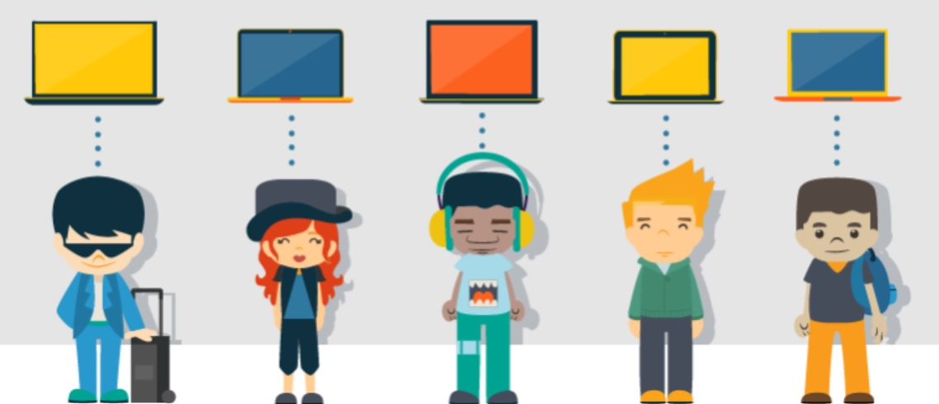
Problem Statement
In the laptop outlets every user don’t know the laptop specifications , like prices of their respective different laptop models and user’s price range what he want to have his own specifications of it .

Slide 4





processor
Ram
Storage
Display

Slide 5

Objectives
The main objective of our project is to predict the laptop by asking some basic questions to the user to know
what type of laptop the user needs
For above we predict the price of the laptop that is close to the real ones .

Slide 6
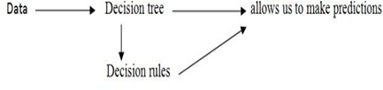
Literature Review
For motivation and Background work we referred to some of the
following Research Papers from online. They are
Laptop Price Prediction Using Machine Learning Approach.
Predicting can be done using any Machine Learning algorithms like linear regression , logistic regression , KNN etc.,
How to deploy the machine learning algorithms to find the accurate & efficient solutions to the given input from the user.

Slide 7

Proposed Methodology
Accuracy depends on the quality of the data. With large data, the prediction stage might be slow. Sensitive to the scale of the data and irrelevant features. Require high memory – need to store all of the training data .
Given that it stores all of the training, it can be computationally expensive.

Slide 8
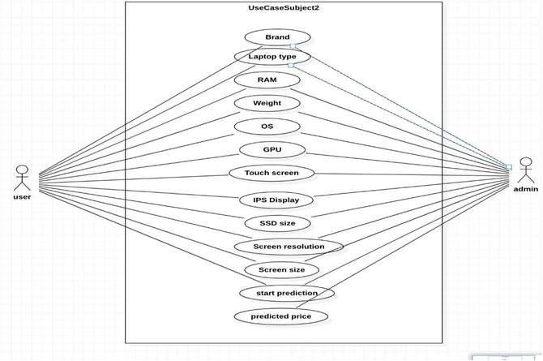
UML Diagrams
Use case Diagram

Slide 9
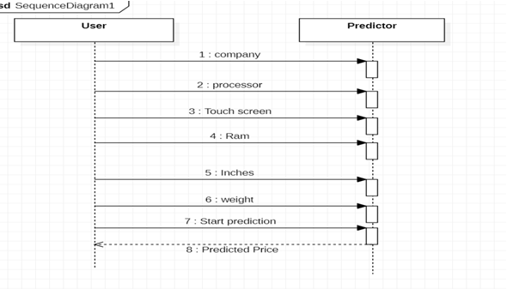
Sequence Diagram

Slide 10
1. Multiple Linear Regression 2. Random Forest 3. Decision Tree 4. KNN
PROPOSED ALGORITHMS

Slide 11
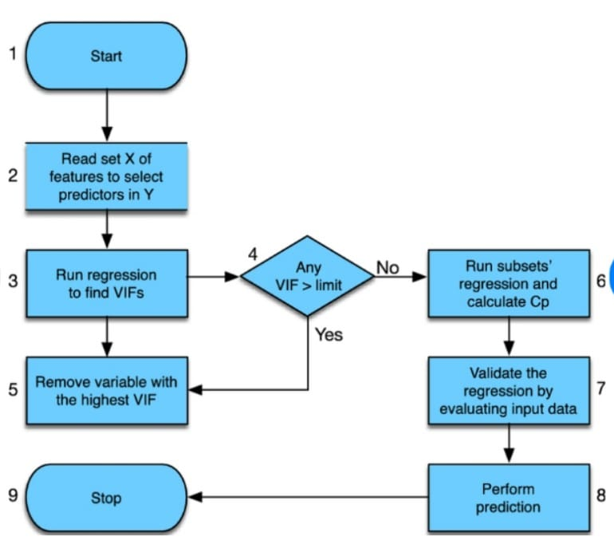
Multiple Linear Regression
It is a statistical technique that uses these model more complex relationships between two or more independent variables and one dependent variable .
Y = β0 + β1x1 + ..+ βkxk + i

Slide 12
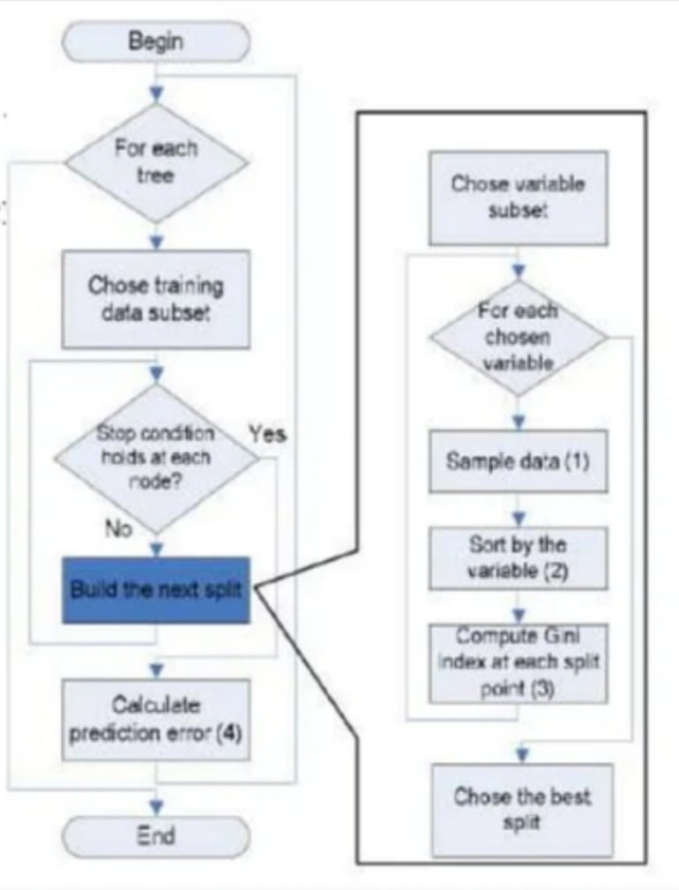
Random Forest
It is a classifier that contains a no of decision tree on various subsets of the given dataset and takes the average to improve the predictive accuracy of that dataset .

Slide 13
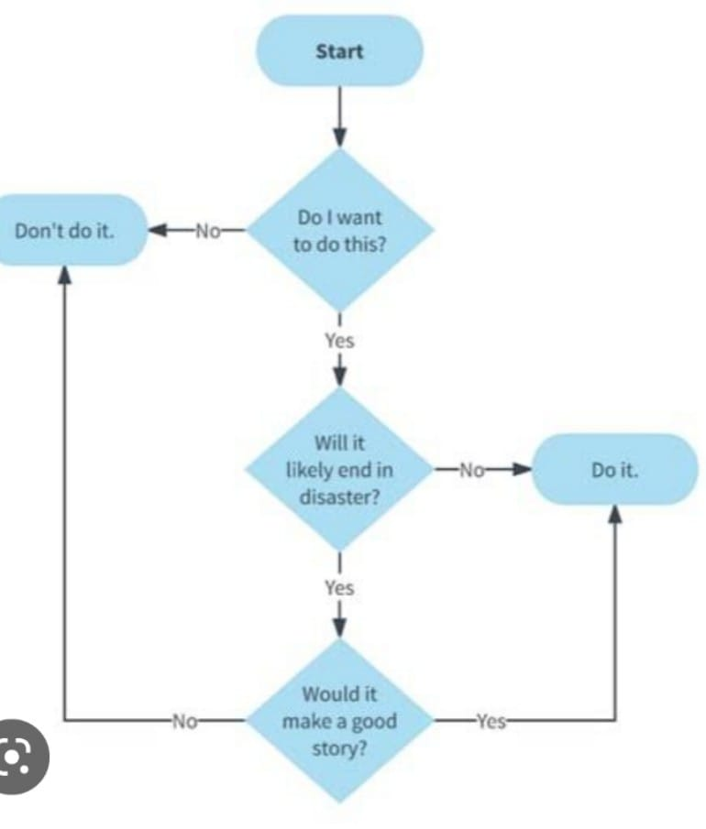
Decision Tree
It is a “Supervised learning technique” , internal nodes represent the features of a dataset , branches represent the decision rules and each leaf node .
EV = (FO*LO) - COST

Slide 14
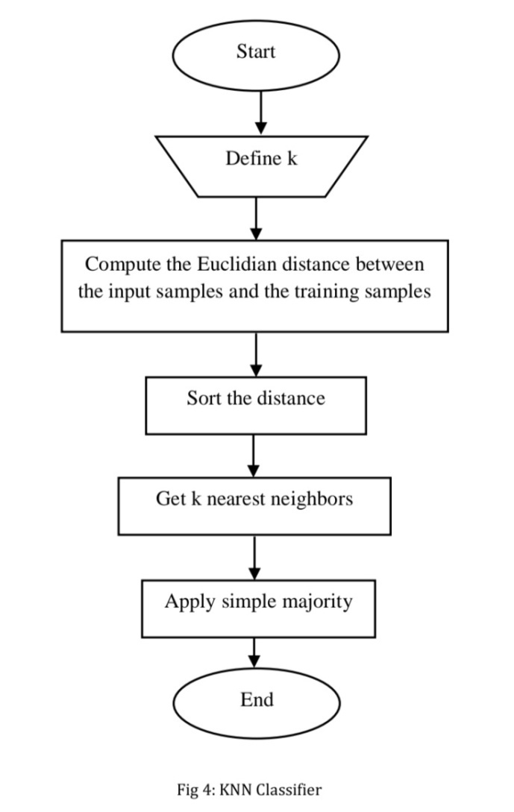
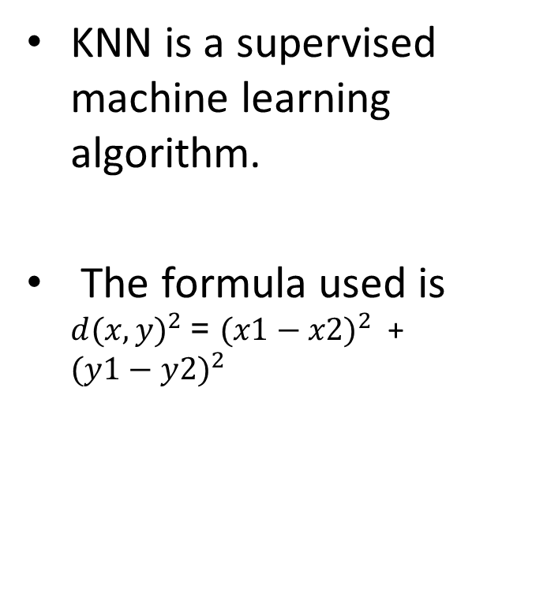
KNN ALGORITHM
KNN is a supervised machine learning algorithm.
The formula used is ${d(x,y)}^{2}$ = ${(x1−x2)}^{2 }$ + ${(y1−y2)}^{2 }$

Slide 15
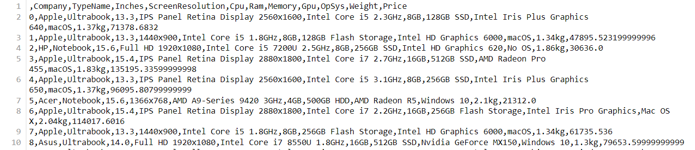
Data Set
For this project, we have obtained my dataset from Kaggle. This dataset contains 1302 rows of data and 12 columns (features) that we could focus on to build our prediction model i.e., we use 12 attributes to predict the price of the laptop.
The dataset consists of 12 attributes * Weight
Brand * Touch Screen
Type of laptop * CPU
RAM * SSD
ROM * Screen Size

Slide 16
Multiple Linear Regression Algorithm
It is a statistical technique that uses multiple linear regression to model more complex relationships between two or more independent variables and one dependent variable is known as multiple linear regression .
It deals with more than two features i.e.., “Predictive and analysis” it allows the relationship between a continuous dependent variable and two or more independent variables .

Slide 17
Random Forest Algorithm
It is a classifier that contains a number of decision tree on various subsets of the given dataset and takes the average to improve the predictive accuracy of that dataset is known as random forest .
The greater number of trees in the forest leads to higher accuracy and prevents the problem of overfitting .

Slide 18
Decision Tree Algorithm
It is a “Supervised learning technique” , internal nodes represent the features of a dataset , branches represent the decision rules and each leaf node represent the outcome is known as decision tree .
It is a graphical representation for getting all the possible solutions to a problem based on given conditions .

Slide 19
KNN Algorithm
The k-nearest neighbor (k-NN) method is a data mining technique.
In this, we consider each of the characteristics in our training set as a different dimension in some space, and take the value an observation has for this characteristic to be its coordinate in that dimension, so getting a set of points in space.
The implementation of algorithm can be noted as below:
Load the data
Initialize K to your chosen number of neighbors

Slide 20
Prediction of Laptop Price Using K-NN Algorithm
This work represents a evaluation of K-NN method for the early prediction of crop yield. K-NN analysis is used for predicting the unknown parameter from the recognized parameters.
In this work we’re thinking about laptop display, size, weight, RAM,ROM, color enter parameters that are the main parameters to be considered for an excellent prediction of laptop.
The unknown cost of laptop may be predicted from the closest known values are calculated from C4.5 algorithms into them used for decision tree on certain sample of data.
To calculate E , p , q values to find the algorithm into it .
Formulae is ;

Slide 21
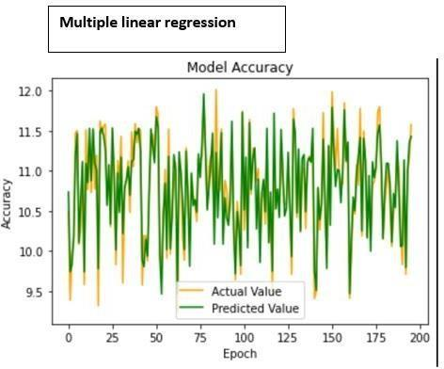
Result

Slide 22
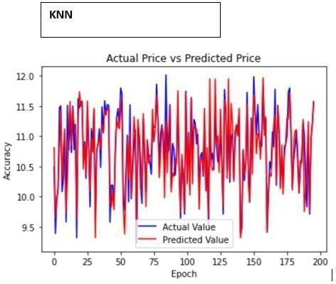
Result

Slide 23
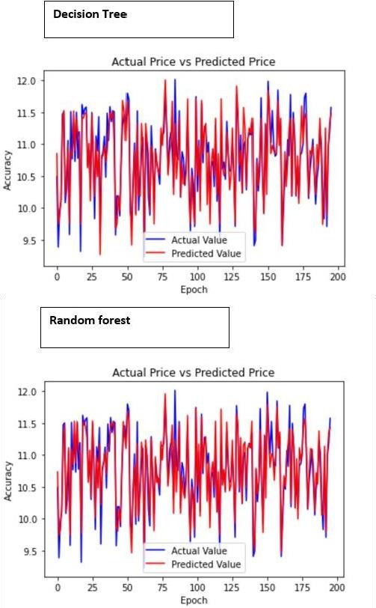
Result

Slide 24
Result
Various models with the proposed
Model Algorithm | Accuracy Rate
Multiple Linear Regression | 80.73%
Random Forest | 88.75%
Decision Tree | 84.69%
KNN | 80.21%

Slide 25
Result
Price Prediction using | Accuracy | Mean Absolute Error
Multiple Linear Regression | 0.8073277448418645 | 0.21017827976428802
Random Forest | 0.8875301429227068 | 0.15875464162243105
Decision Tree | 0.8469387025658242 | 0.18222142011995746
KNN | 0.8021984604448553 | 0.19319716721521116

Slide 26
Conclusion
We created a website that Predicts the prices of laptops using the user’s desired configurations and using laptop price predictors and gaining knowledge of using the Decision Tree algorithm makes it easy for students, in particular in deciding the choice of laptop computer specifications that are most ideal for students to meet pupil desires and by the buying energy of students. Students no longer want to appear for various sources to discover laptop specs that are needed by college students in assembly the wishes of students because the laptop computer specifications from the results of the computer gaining knowledge of application have furnished the most perfect specs with the prices of their laptops.

Slide 27
References
https://github.com/mathangpeddi/Laptop-Prices-Predictor
https://github.com/Paras-bakshi/laptop-price-Predictor
https://github.com/NehalGund/Laptop-Price-Prediction
Aminah Md Yusof and Syuhaida Ismail, Multiple Regressions in Analyzing House Price Variations. IBIMA Publishing Communications of the IBIMA Vol. 2012 (2012), Article ID 383101, 9 pages DOI: 10.5171/2012.383101.
Babyak, M. A. What you see may not be what you get: A brief, nontechnical introduction to overfitting regression-type models. Psychosomatic Medicine, 66(3), 411-421.
Atharva shoogles, Priyanka chair, Akshata gaud, Jinal Jain.House Price Forecasting using Data Mining Techniques International Journal of Advanced Research in Computer and Communication Engineering ISO 3297:2007 Certified Vol. 6, Issue 12, December
2017 Darshan Sanghani, Kelby Erickson, and Mohammad Al Hasan Predicting Zillow Estimation Error Using Linear Regression and Gradient Boosting, IEEE 14th International Conference on MobilAd Hoc and Sensor Systems (MASS), Page(s):530 - 534.

Slide 28
THANK YOU

